Slide 1
Regime-Based Momentum Trading Strategy Using Hidden Markov Models
Boston University Faculty of Computing & Data Sciences (CDS)
Undergraduate Researcher: Yulian Gogov

Slide 2
Abstract
Generate synthetic price series via Monte Carlo simulation using BTC return statistics (mean & volatility)
Designed a momentum-based trading strategy using 5 years of BTC price and volume data
Combined K-Means clustering and Hidden Markov Models (HMM) to detect real-time market regimes
Used regime signals to generate buy/sell decisions and simulate trades on synthetic price series data
Compared strategy returns to buy-and-hold benchmarks using PnL and Sharpe ratios

Slide 3
Modeling Markets as Regime-Driven Systems
Generate synthetic price series via Monte Carlo simulation using BTC return statistics (mean & volatility)
Financial markets are not random — they transition through distinct phases:
Bullish: upward trends, lower volatility
Bearish: downward pressure, rising volatility
Neutral: sideways movement, choppy/noisy behavior
These regimes can persist over varying time horizons and exhibit distinct statistical behaviors

Slide 4
Why Use HMM for Market Regimes?
Generate synthetic price series via Monte Carlo simulation using BTC return statistics (mean & volatility)
Markets operate in hidden states (bullish, bearish, neutral) — we can’t observe them directly
HMMs explicitly model hidden latent states and infer them from observed data
Crucially, HMMs learn how long states typically last and how likely transitions are
e.g. If we're in a bullish regime, HMM knows whether it's likely to continue or switch soon
This captures the temporal persistence of trends and reversals

Slide 5
Why Use Clustering for Market Regimes?
Generate synthetic price series via Monte Carlo simulation using BTC return statistics (mean & volatility)
Training an HMM on raw indicators makes pattern detection and temporal modeling harder because the data is high-dimensional and noisy
K-Means groups similar market conditions using Euclidean distance in N-dimensional indicator space
Converts noisy indicator snapshots into clean, structured “cluster states”
Reduces dimensionality and noise and highlights meaningful behavior
Acts like “chewing the data” before feeding it to the HMM

Slide 6
Pipeline
Data Collection
Fetched 5 years of BTC price & volume data (4-hour intervals) from Binance API
Feature Engineering
Calculated technical indicators/features (e.g., returns, volatility, momentum metrics)
Clustering Regime Detection
Applied multi-phase K-Means clustering to group similar market conditions
HMM Training
Trained a 3 hidden state HMM to learn latent regimes using clustered sequences
Synthetic Data Simulation
Generated synthetic price path using historical return statistics (μ, σ)
Back Testing & Performance Evaluation
Simulated real-time regime detection on synthetic data
Deployed regime-aware trading logic on synthetic charts via Monte Carlo
Compared PnLs and Sharpe Ratios between HMM strategy and buy-and-hold
Labeled real-time market states as bullish, bearish, or neutral

Slide 7
Data Collection & Feature Engineering
Created a CSV as database (11,000 + rows)
Step 1: Fetch Raw Data Function
Added Columns: 'open_time', 'open', 'high', 'low', 'close', 'volume’
Pulled from Binance Client API
Step 2: Derive Feature/Indicator Functions
Added Columns: RSI, SMA/EMA/MACD, Bollinger Bands, Rolling Volatility (over 7, 40, 120 rows), Rolling Returns (over 1, 5, 20 rows)
Computed with mathematical formulas

Slide 8
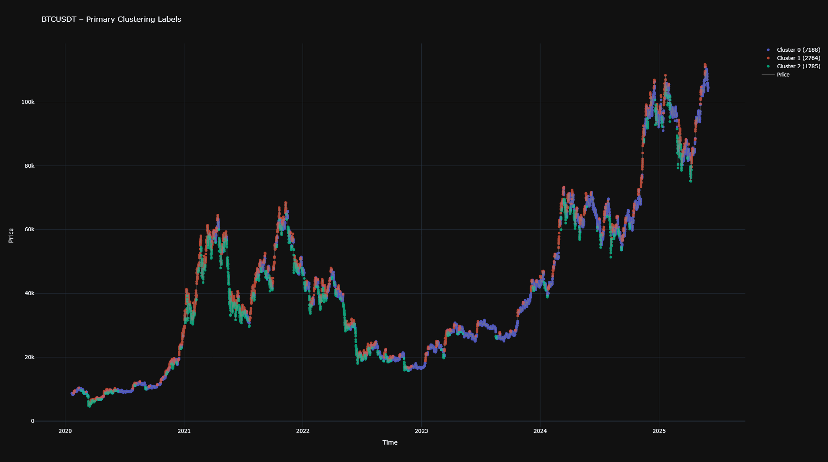
Multi-Phase K-Means Clustering: Phase 1
Primary Clustering Phase
K-Means classify each row/datapoint into 3 clusters based on features from Data Collection & Feature Engineering: Step 2
The chart shows that Euclidean distance classification (K-Means) with optimal feature selection does a sufficient job at distinguishing between market regimes (bullish, bearish, and neutral)

Slide 9
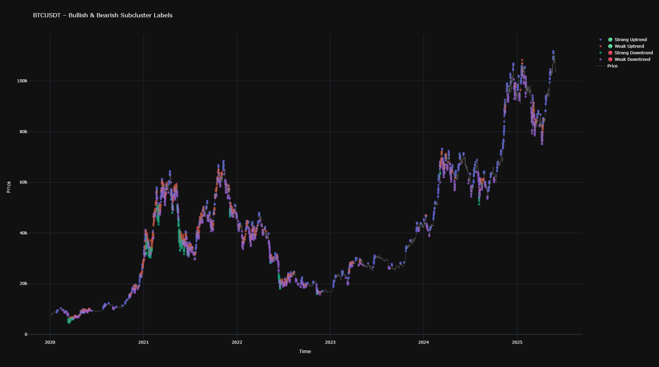
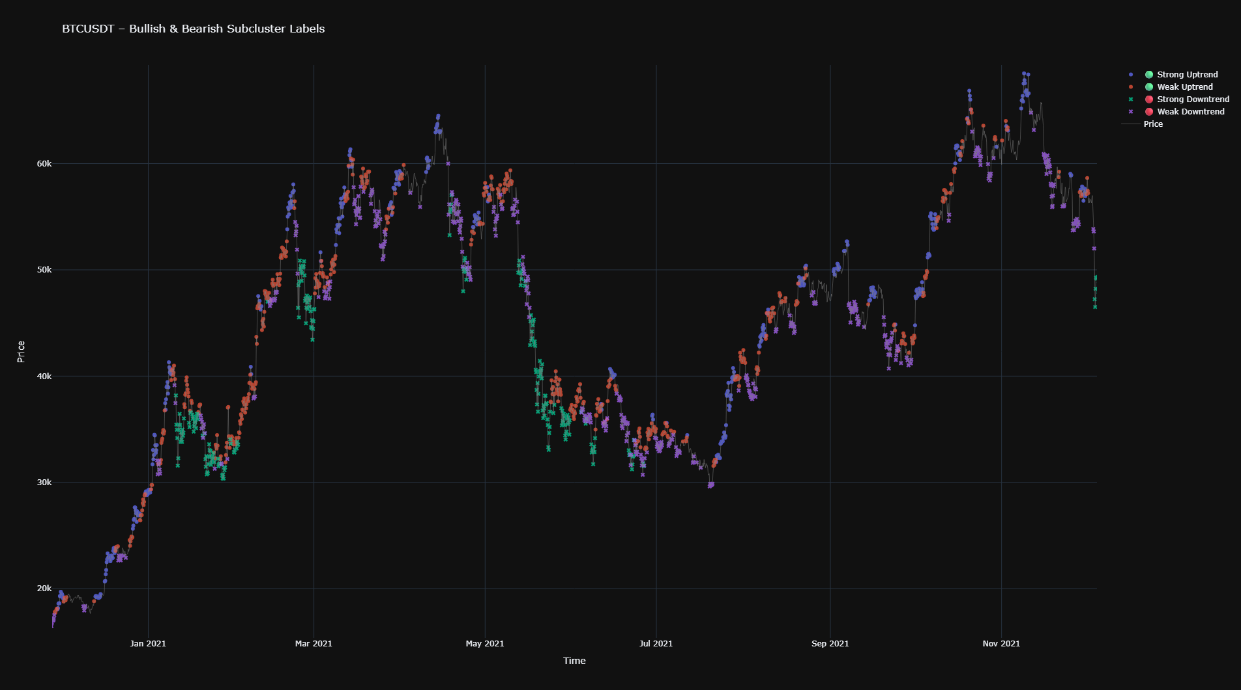
Multi-Phase K-Means Clustering: Phase 2
Sub-Clustering Phase: Bullish/Bearish
Apply an additional 2-cluster K-Means classification on both bullish and bearish clusters
The zoomed in chart shows the additional clustering hints at a change in momentum during uptrends and downtrends in terms of “strength”
Zoomed in: Jan 2021-June 2021

Slide 10
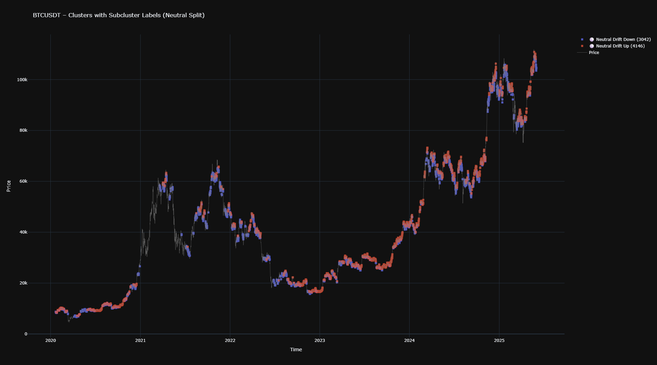
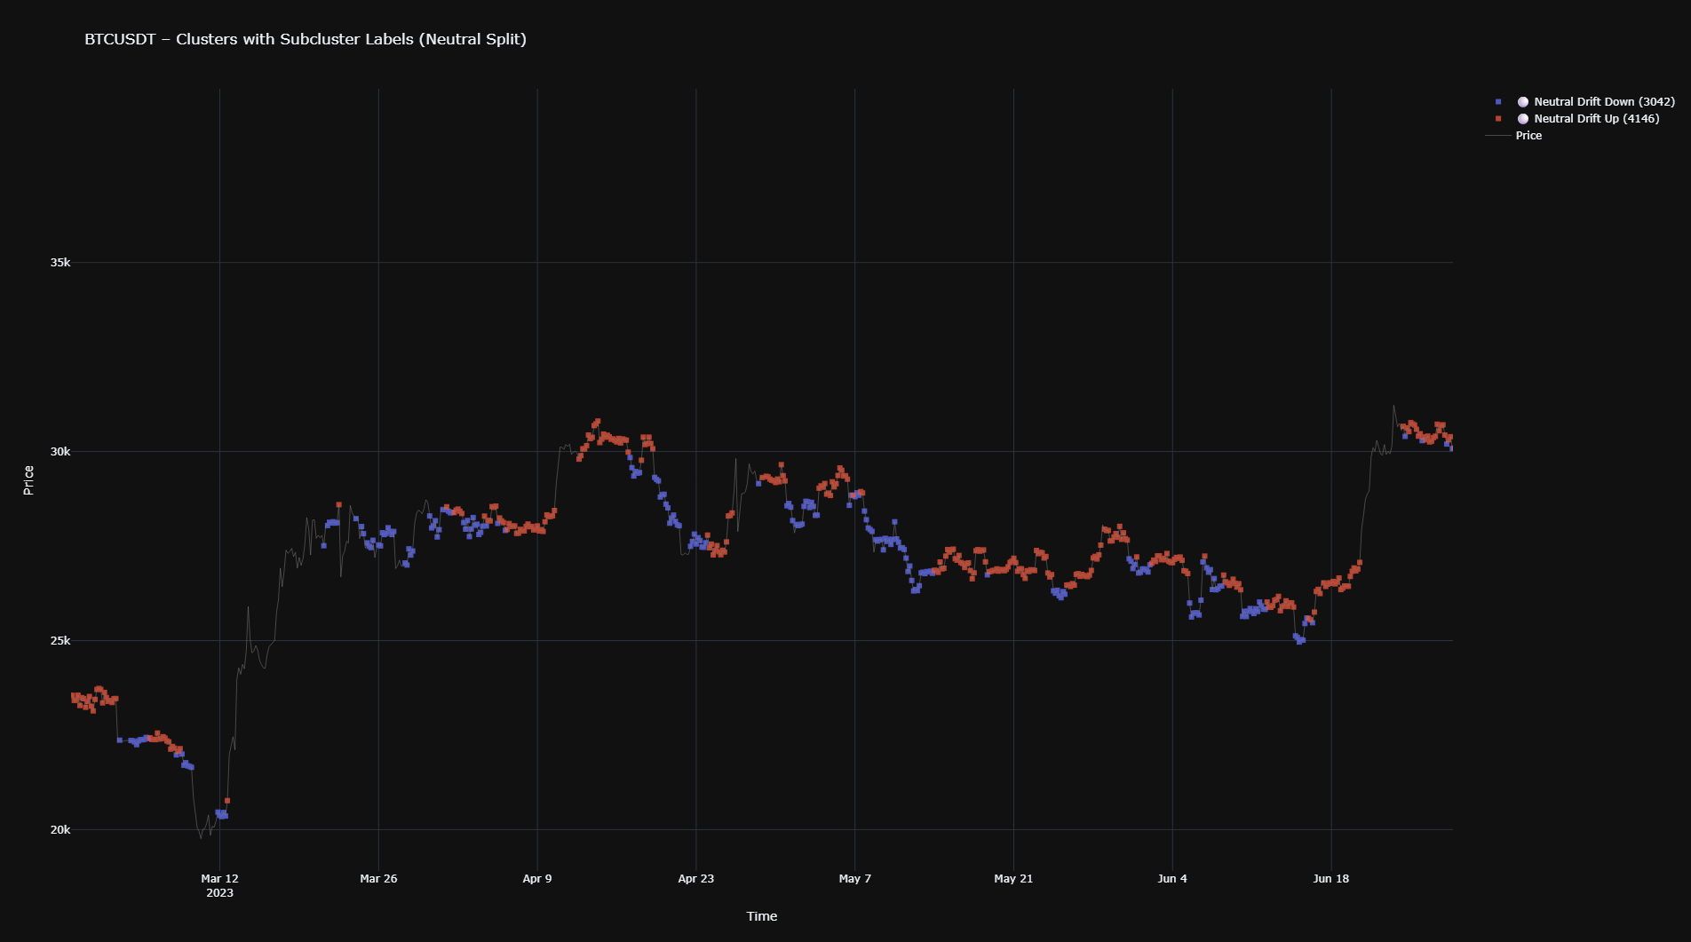
Multi-Phase K-Means Clustering: Phase 3
Sub-Clustering Phase: Neutral
Apply an additional 2-cluster K-Means classification on the neutral cluster
The zoomed in chart shows the additional clustering draws a distinction between upward and downward price shifts in the primary neutral cluster
Zoomed in: March 2023 – June 2023

Slide 11
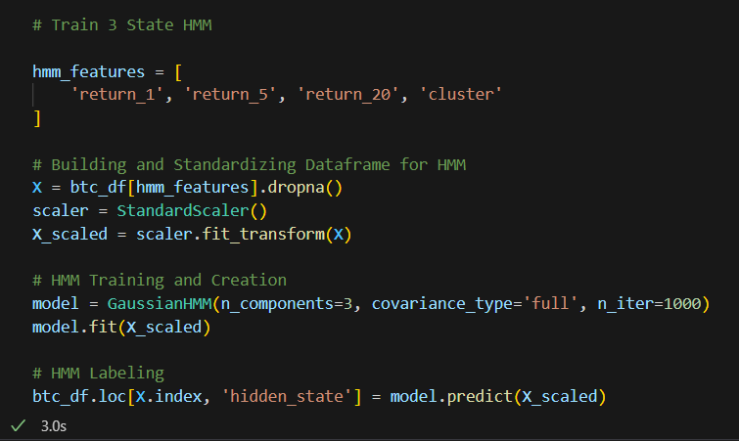
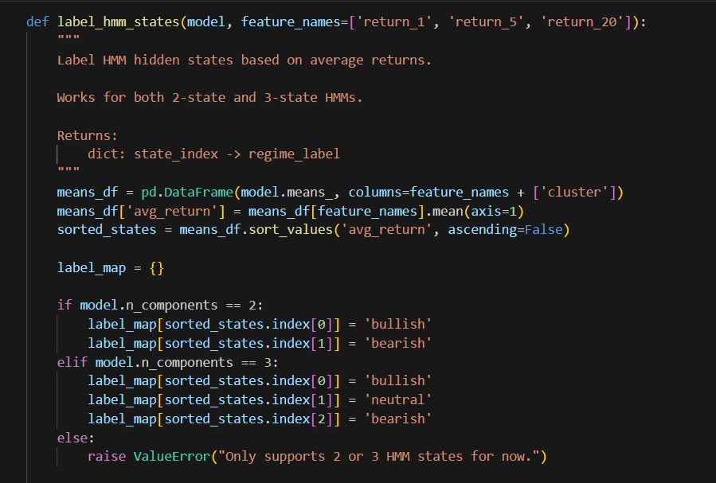
HMM Training
Trained a 3 hidden state HMM on historical rolling returns and K-Means clustering data
Created an average returns-based classifier function that labels the hidden states as bullish, bearish, and neutral market regimes

Slide 12
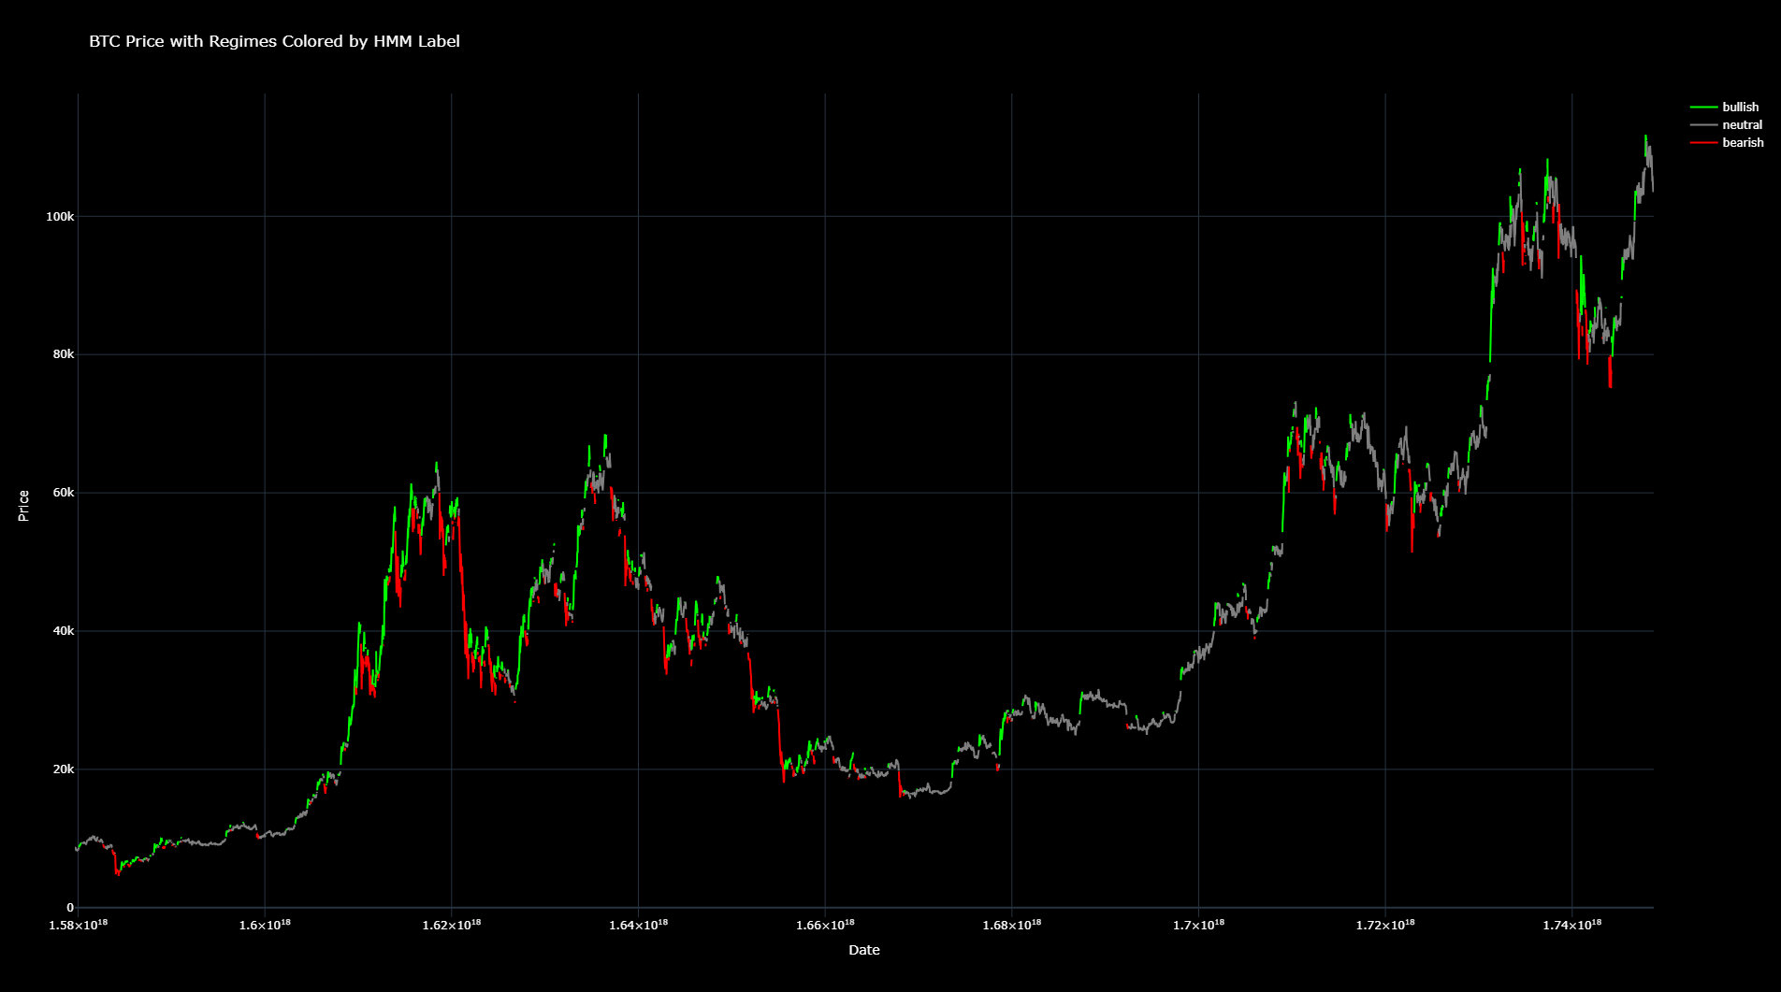

Slide 13
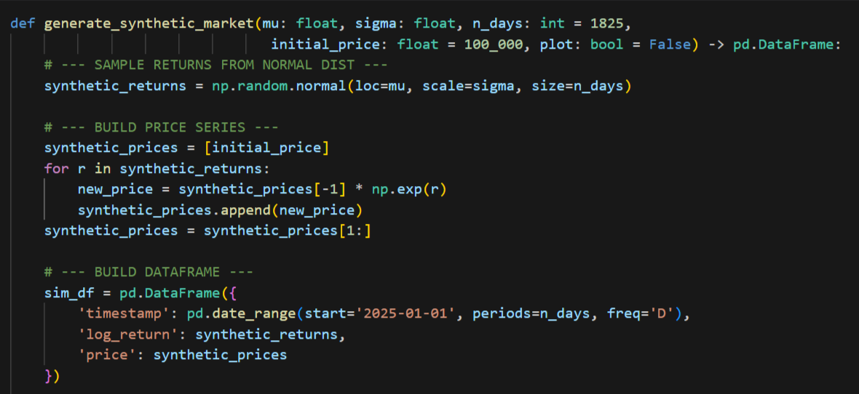
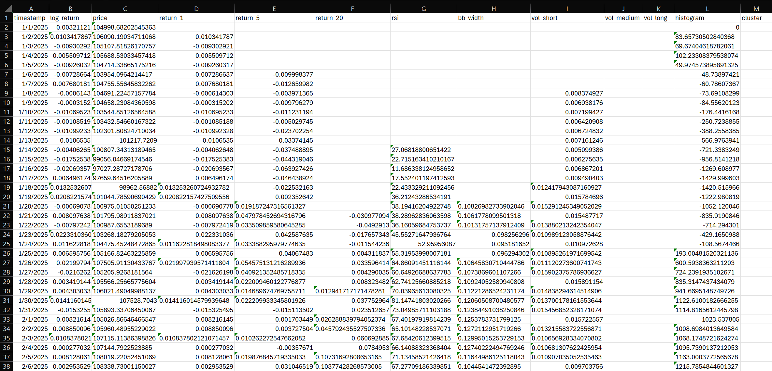
Synthetic Future Price Data
Generate 5 years of synthetic future BTC price series based on historical return statistics (μ, σ)
Derived key features/indicators (rolling returns, clustering, etc.)

Slide 14
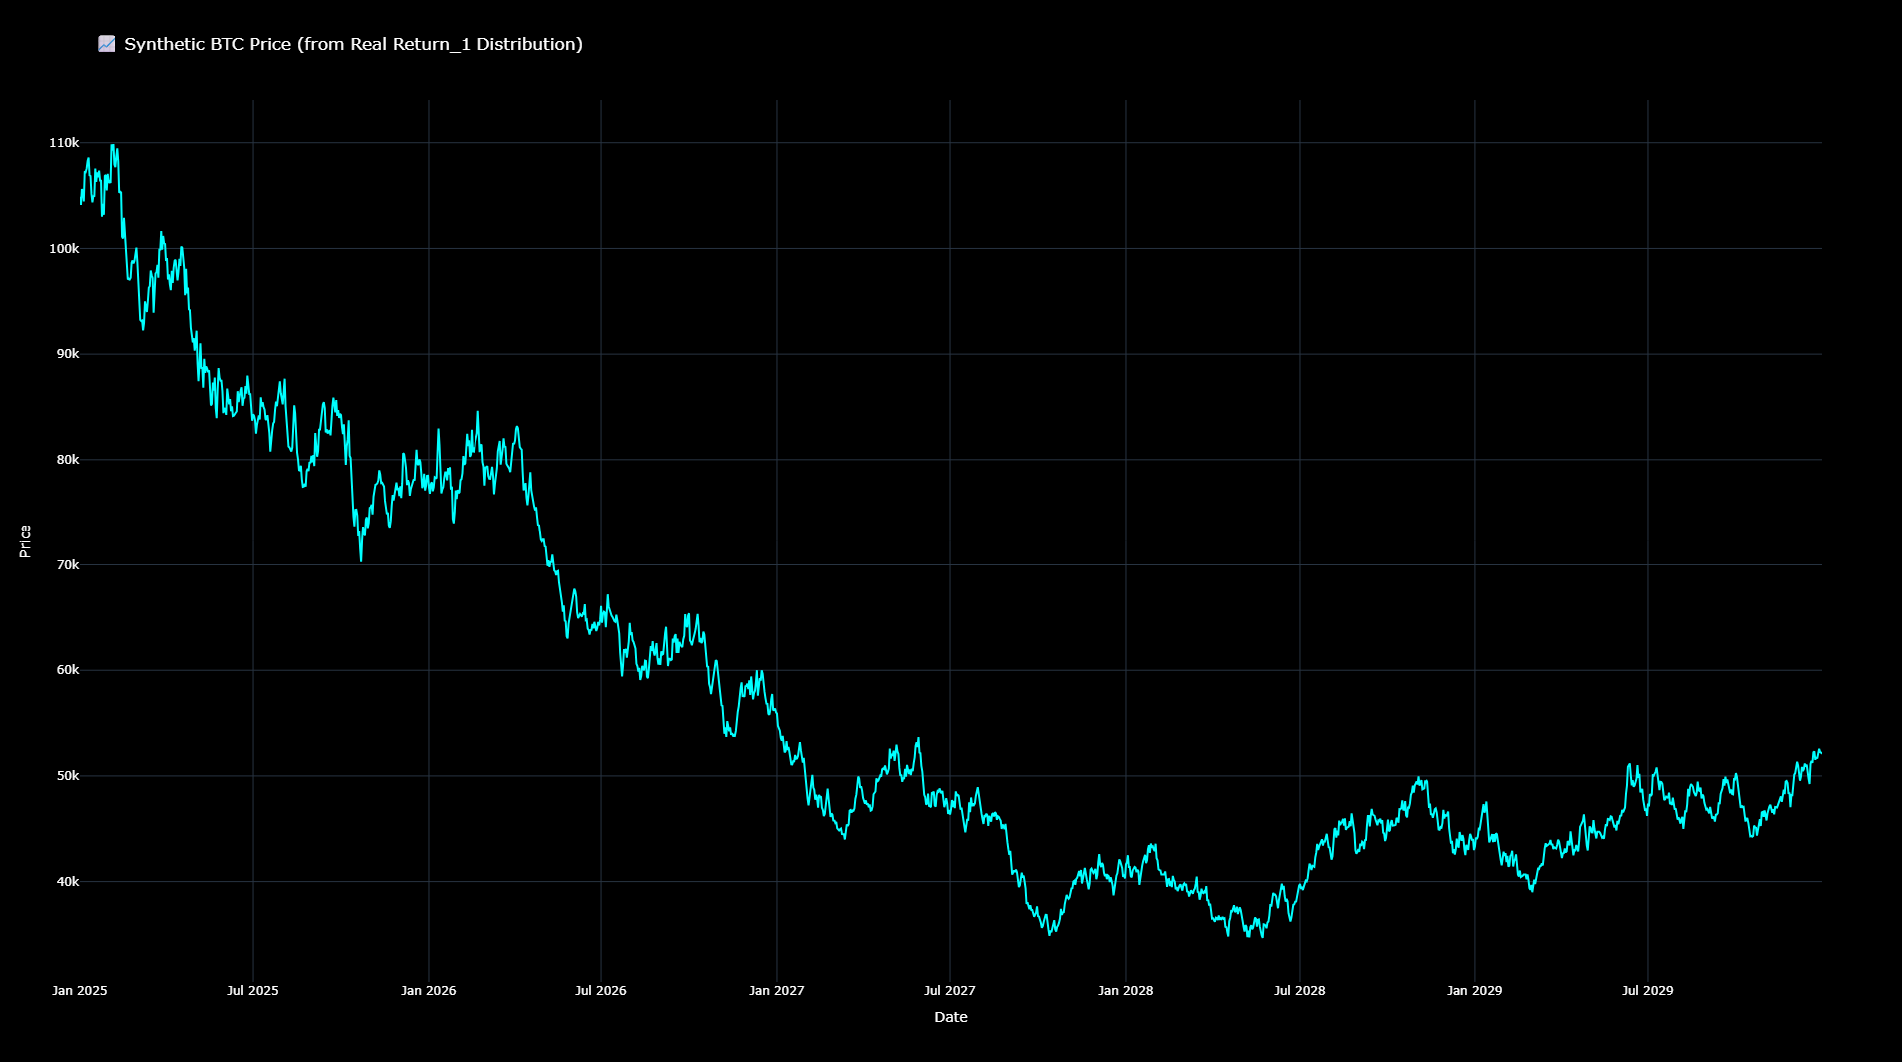
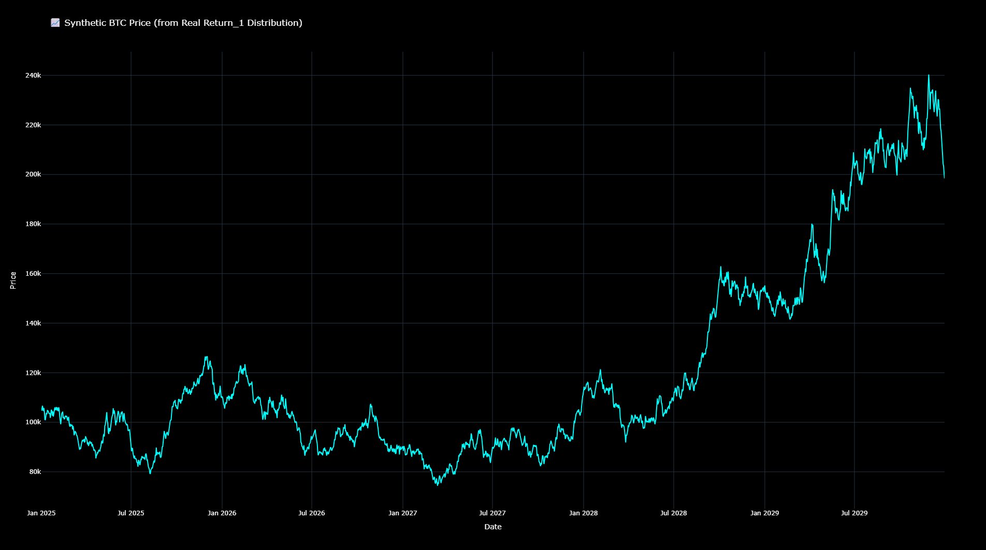
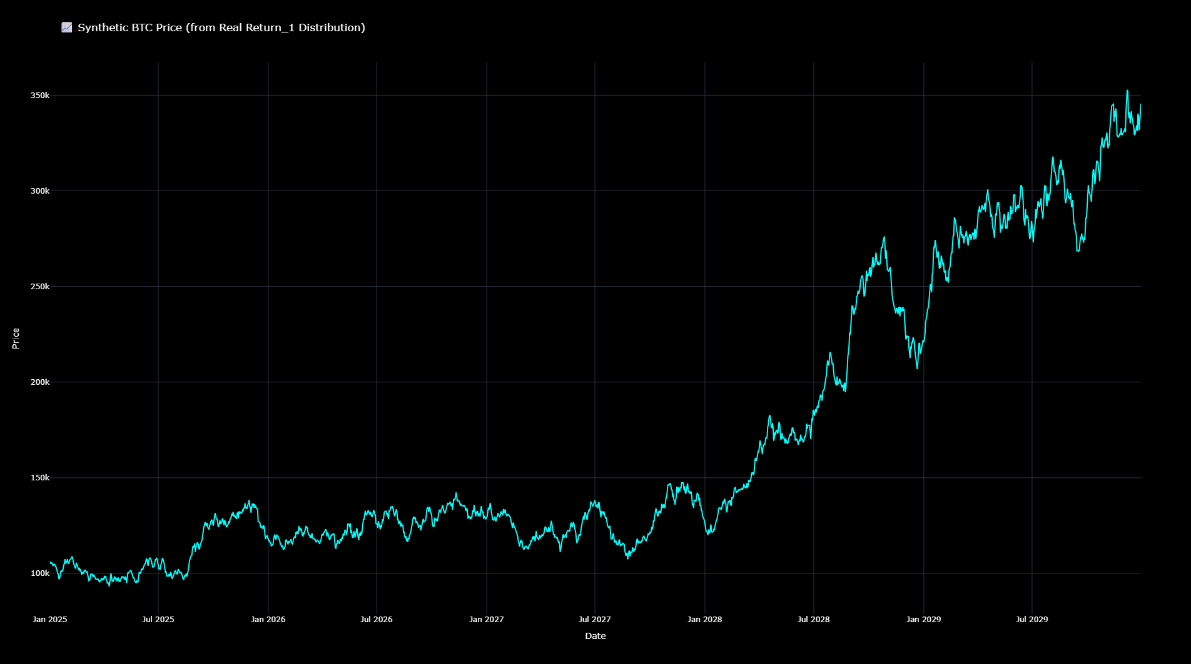
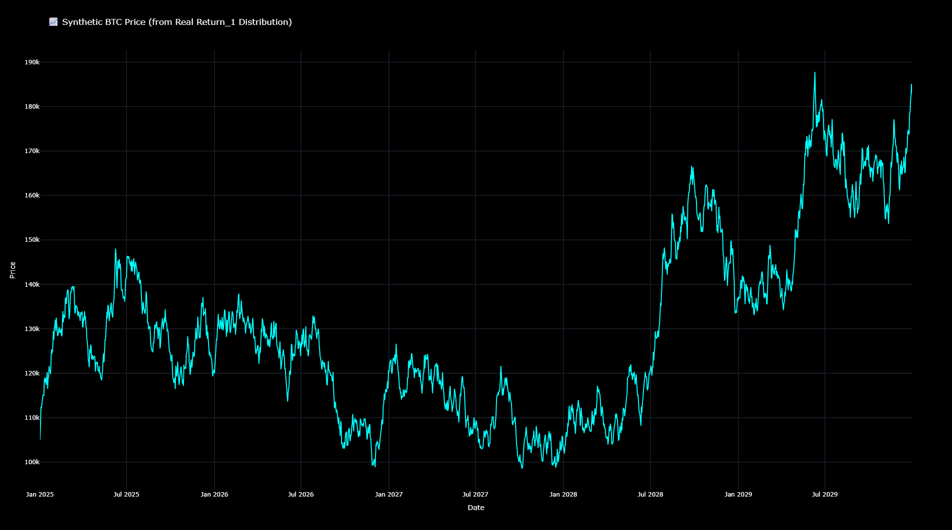

Slide 15
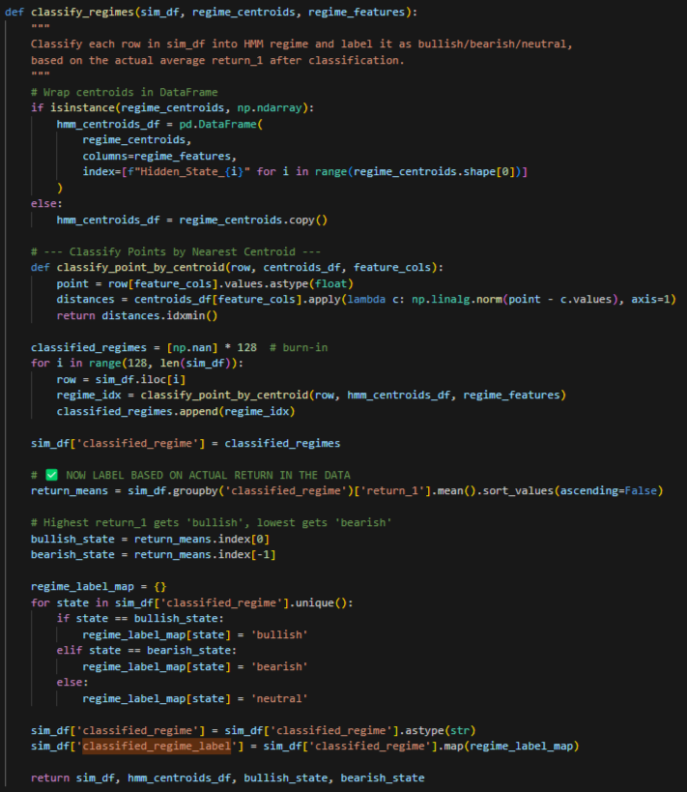
Running Simulations on the Synthetic Data
Run a for loop through the synthetic data to simulate a streaming price chart
Mimics how a real trading system would encounter data — sequentially and without foresight (no look ahead bias)
At each new price point, the model classifies the point as bullish or bearish
Calculated through the point’s Euclidean distance to each hidden state’s mean vector

Slide 16
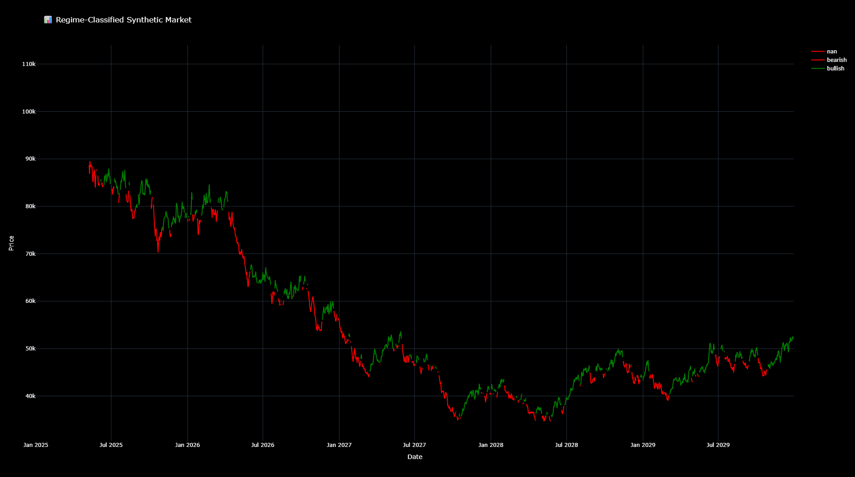
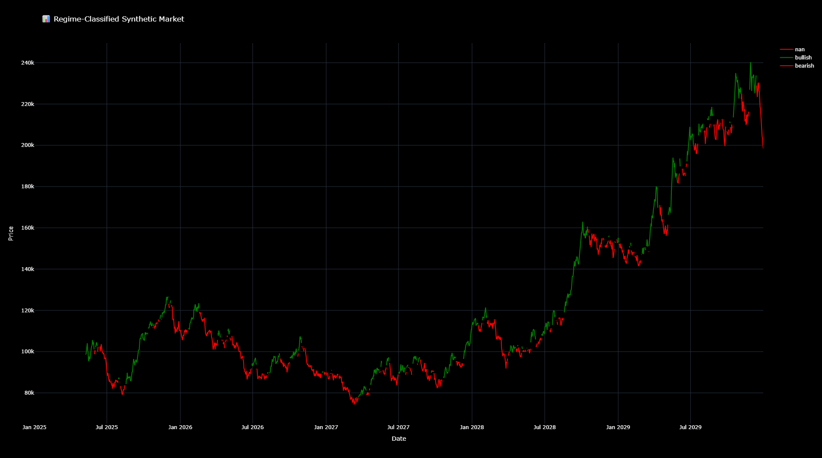
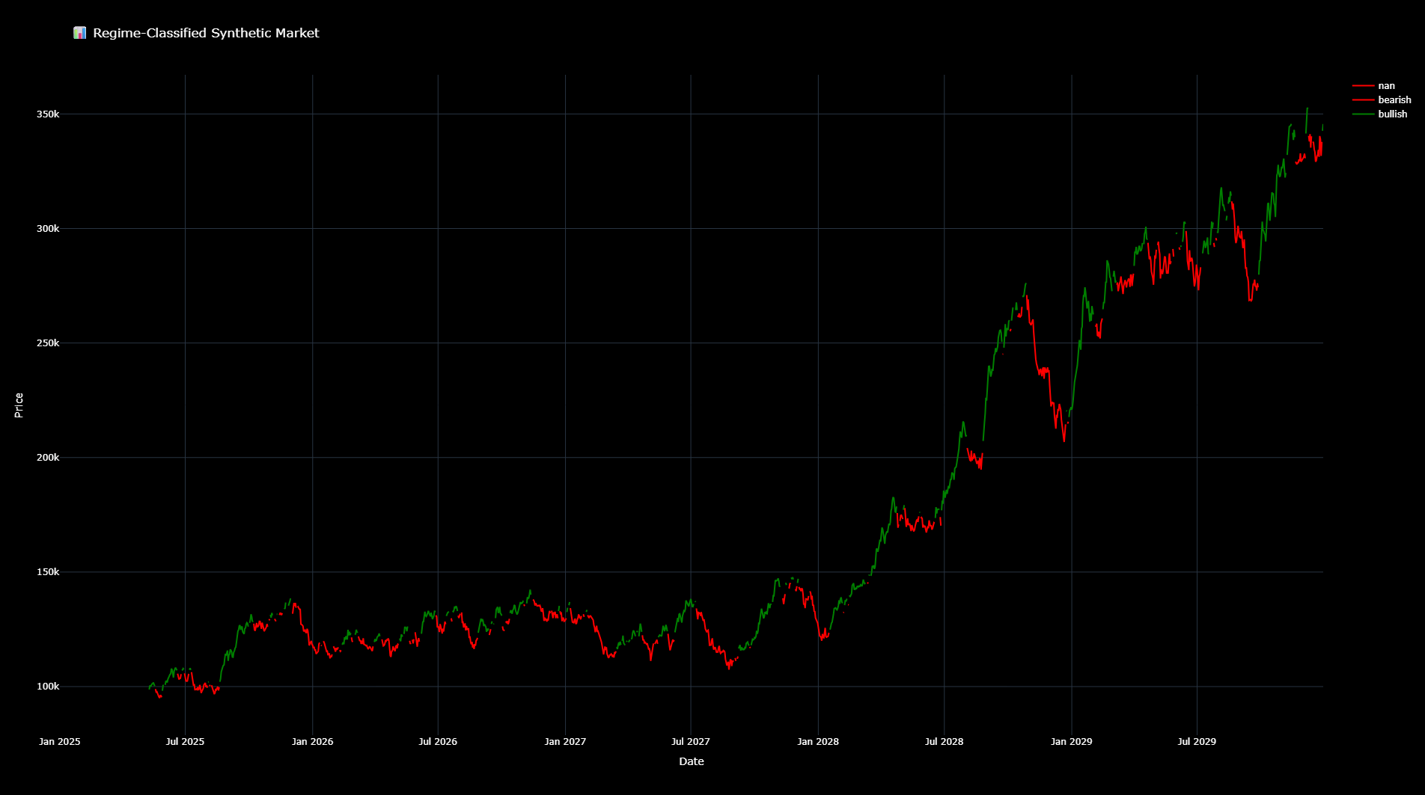
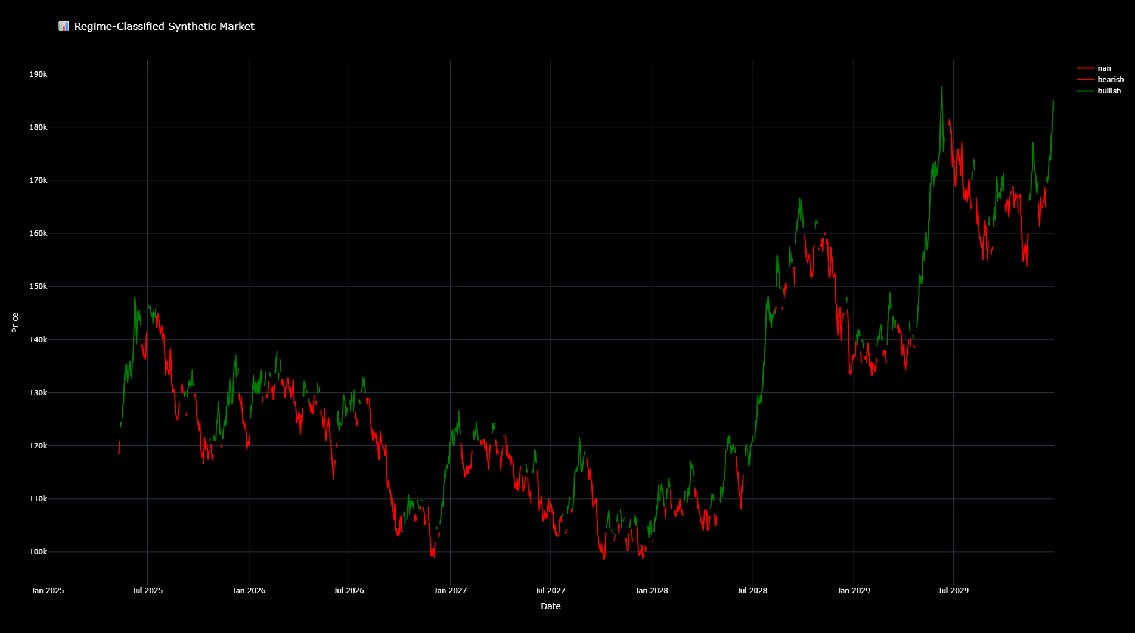

Slide 17
Evaluating Our Simulation
Limitation: Synthetic price paths are generated using a normal distribution of past returns, which oversimplifies market behavior
Real price movements depend on external factors like news, fundamentals, and order flow
Despite limitations, this simulation is powerful because it allows us to test strategy robustness across many possible futures

Slide 18
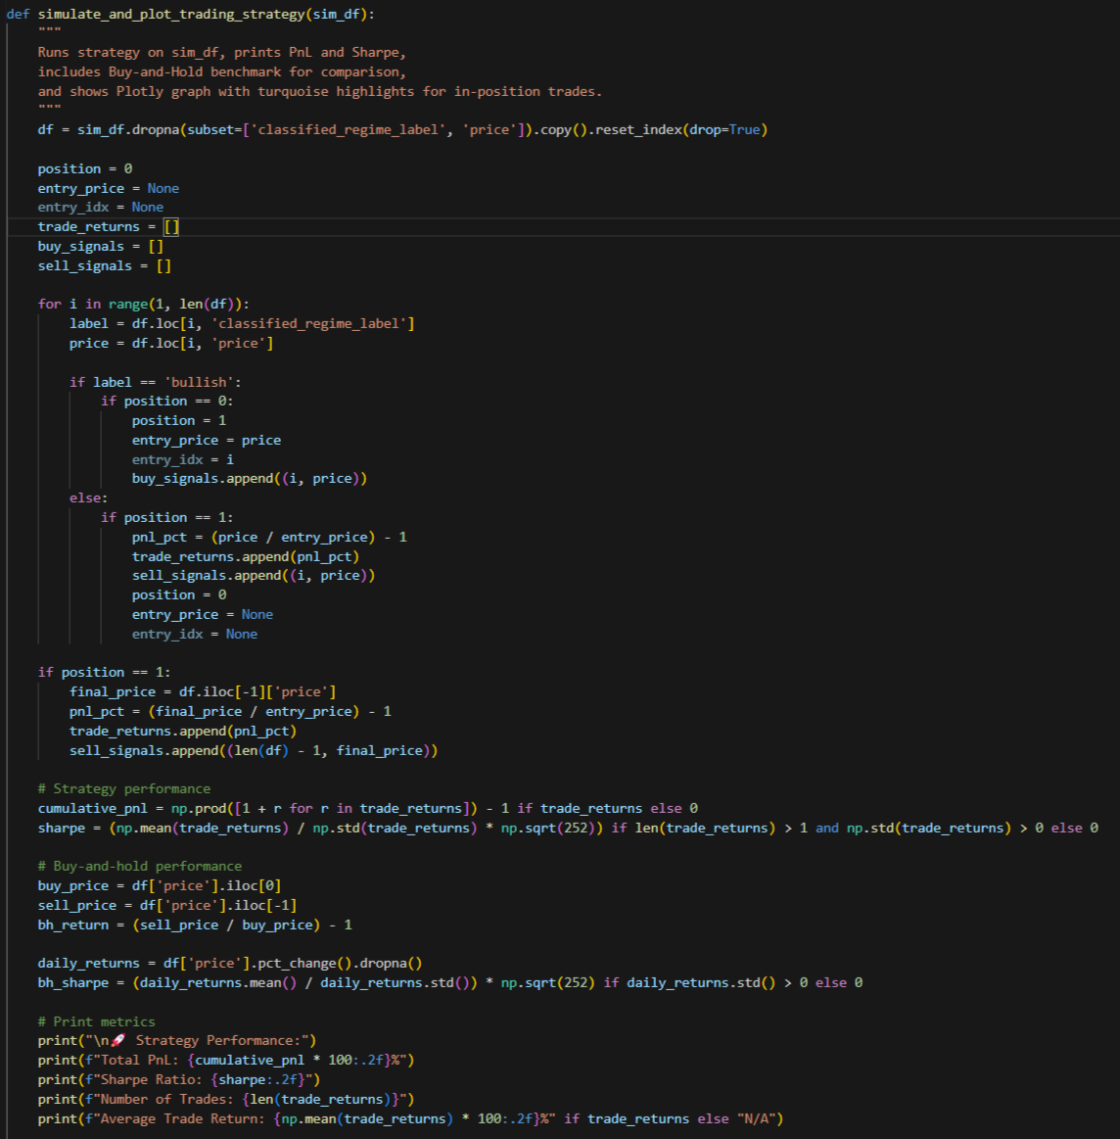
Back Testing
Trading Strategy: open or hold long positions on bullish price points and sell or remain in cash on bearish points
Performance Metrics: PnL, Sharpe Ratio, and graph

Slide 19
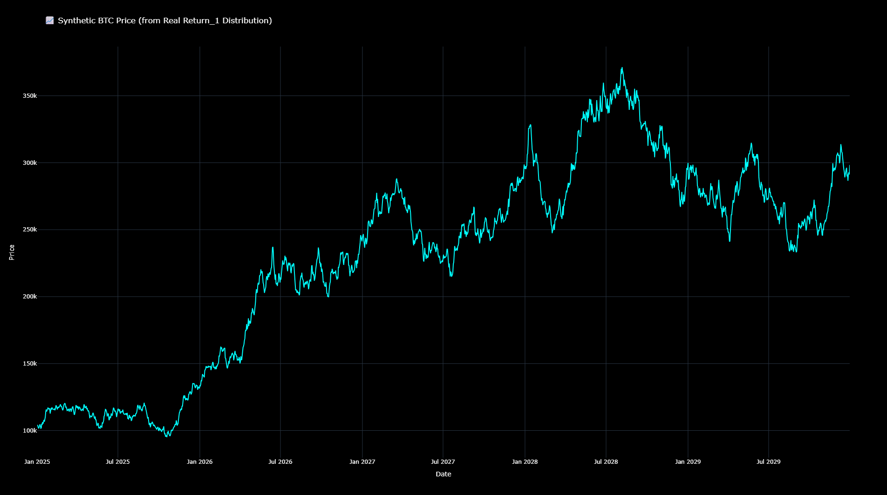
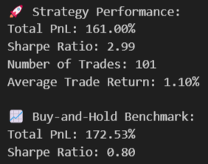
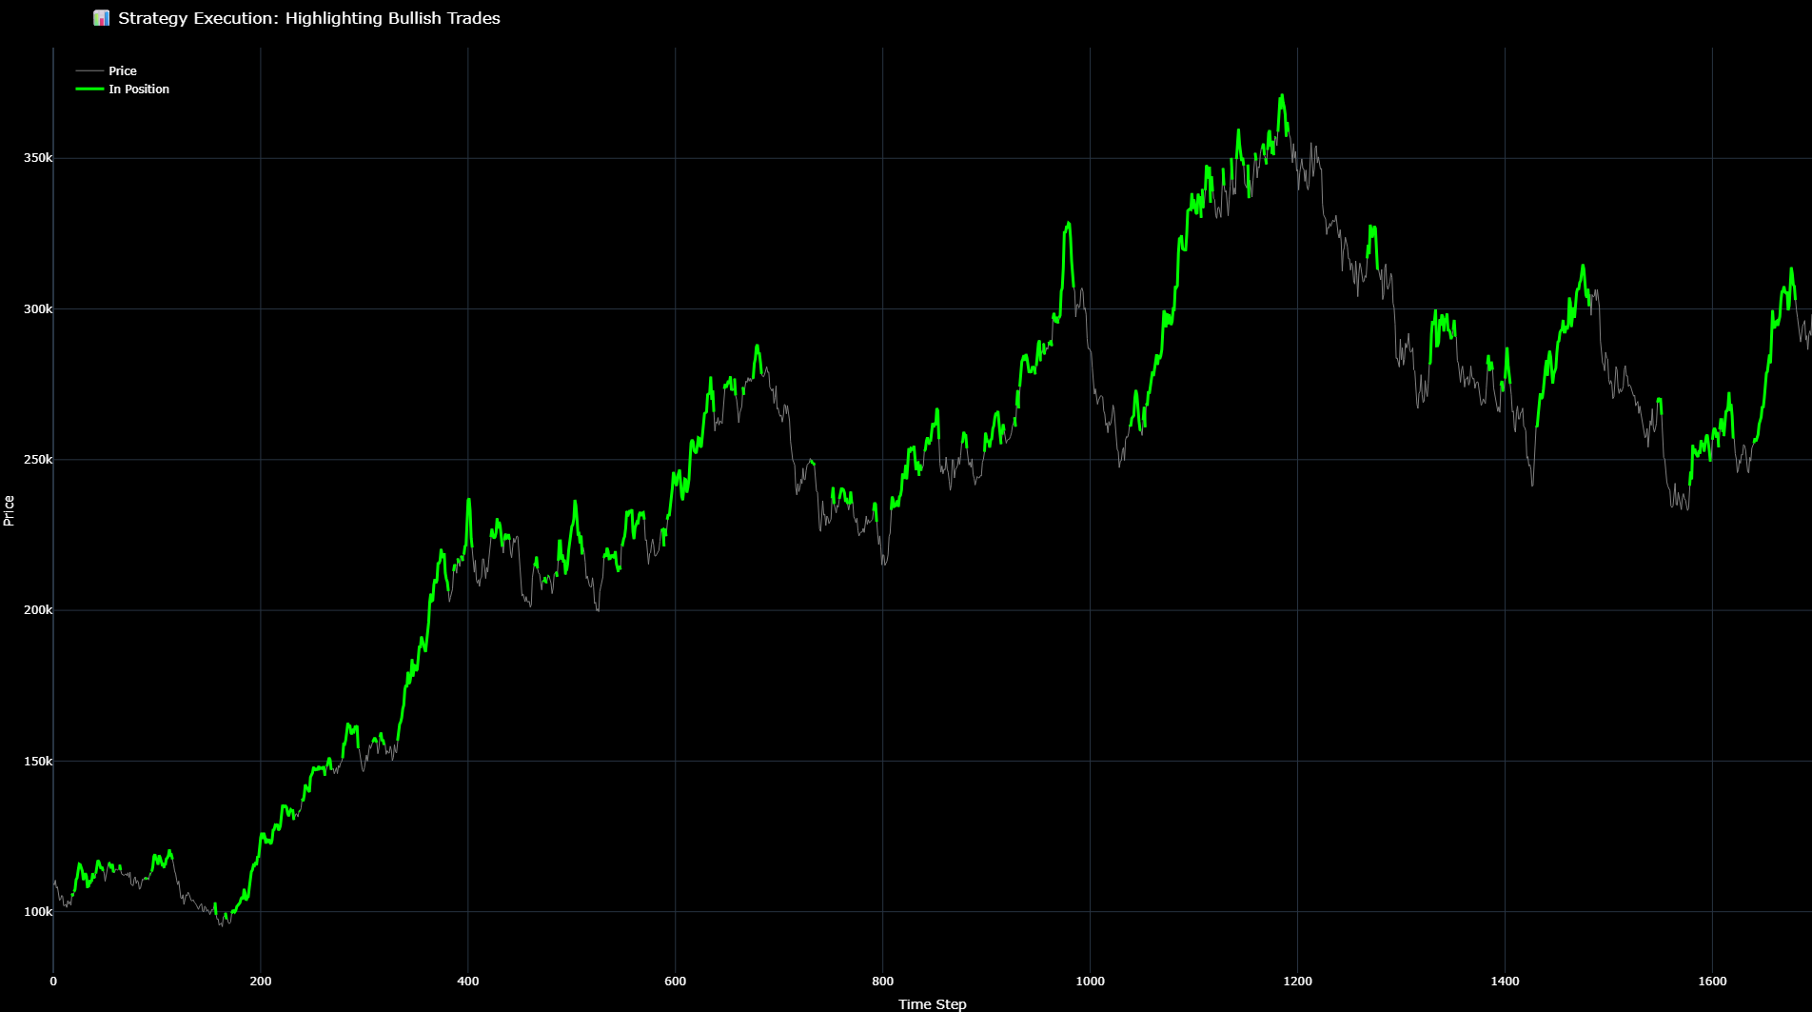
Back Testing a Bull Market
Synthetic Price Chart (Buy-and-Hold)
Highlighted Trades

Slide 20
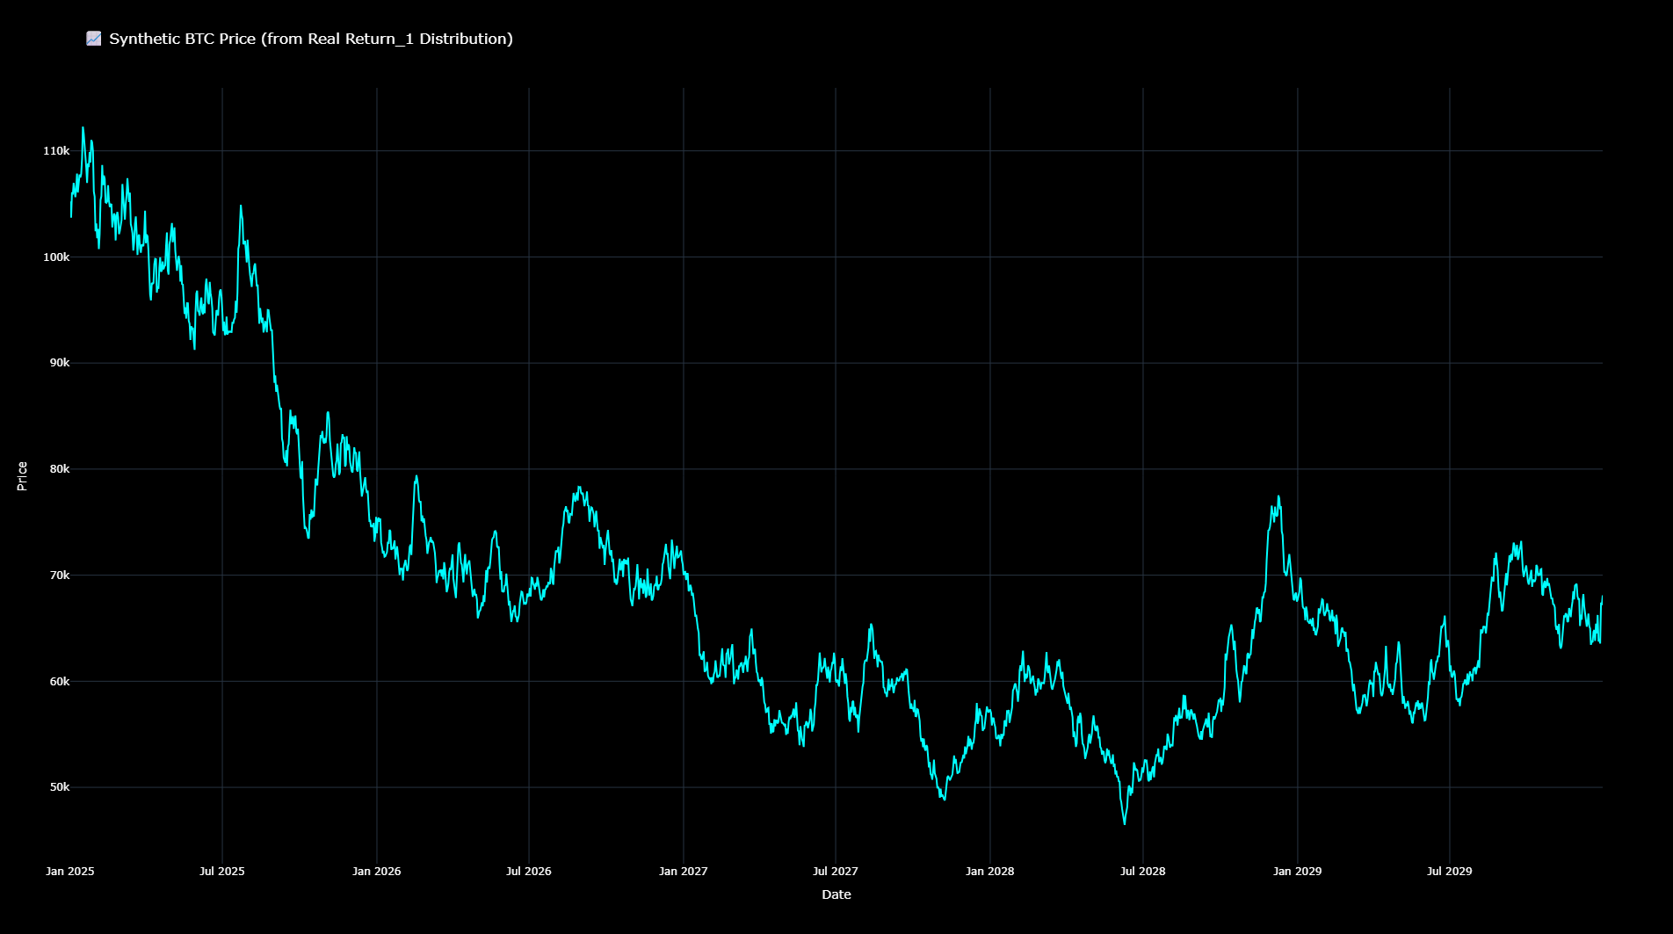
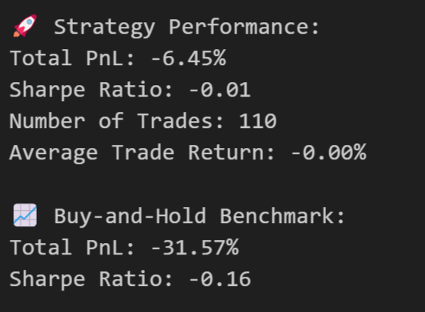
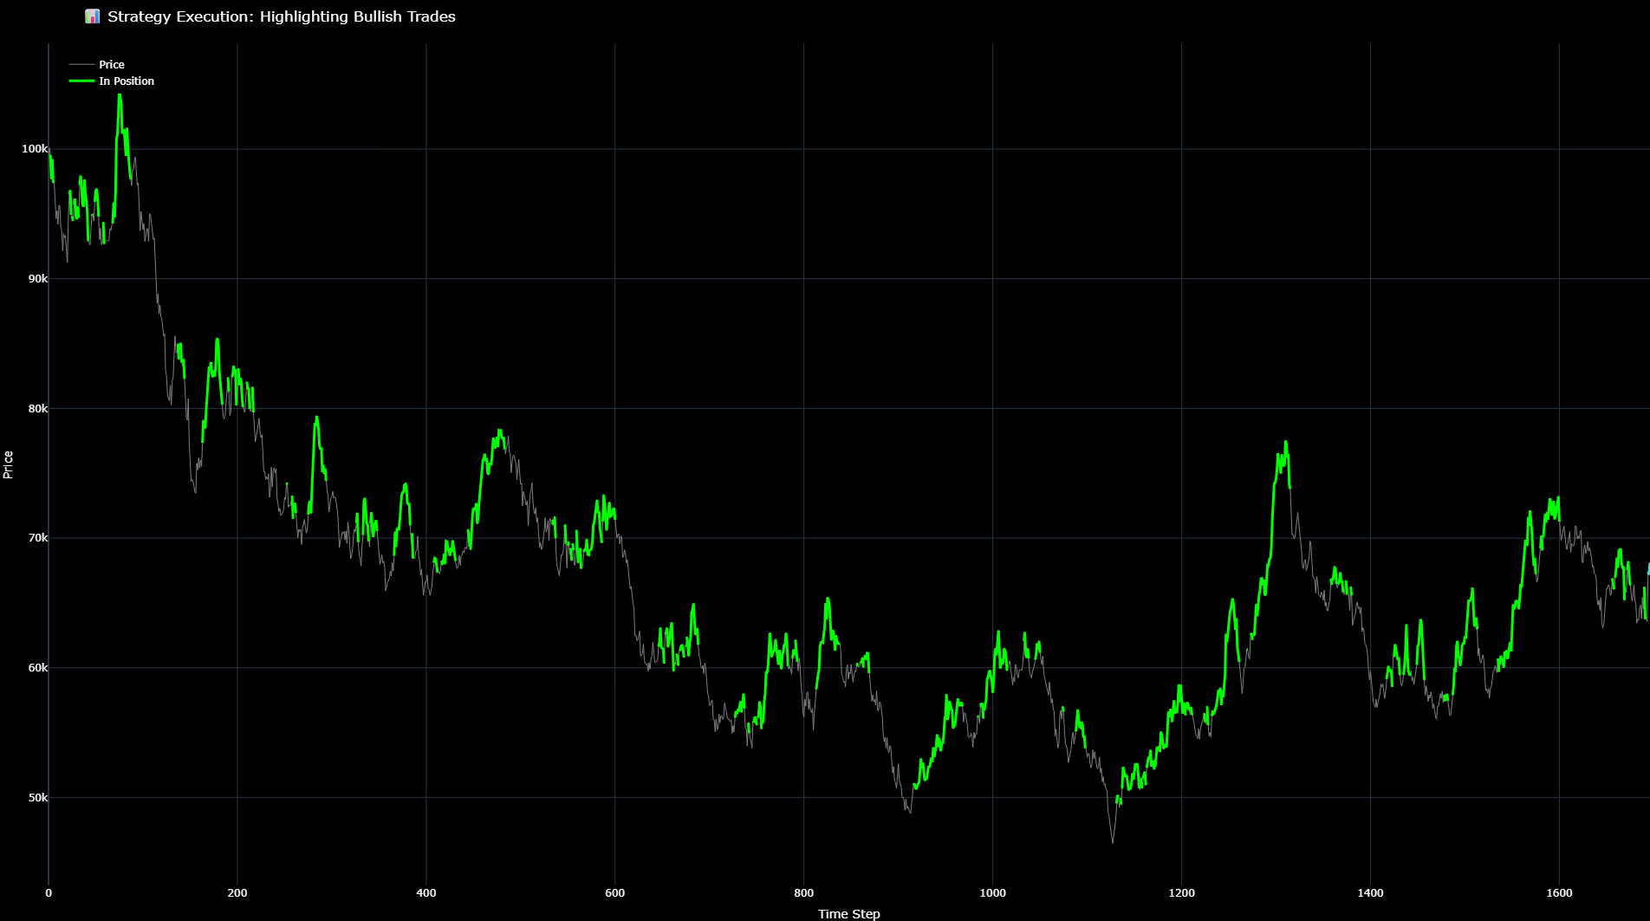
Back Testing a Bear Market
Synthetic Price Chart (Buy-and-Hold)
Highlighted Trades

Slide 21
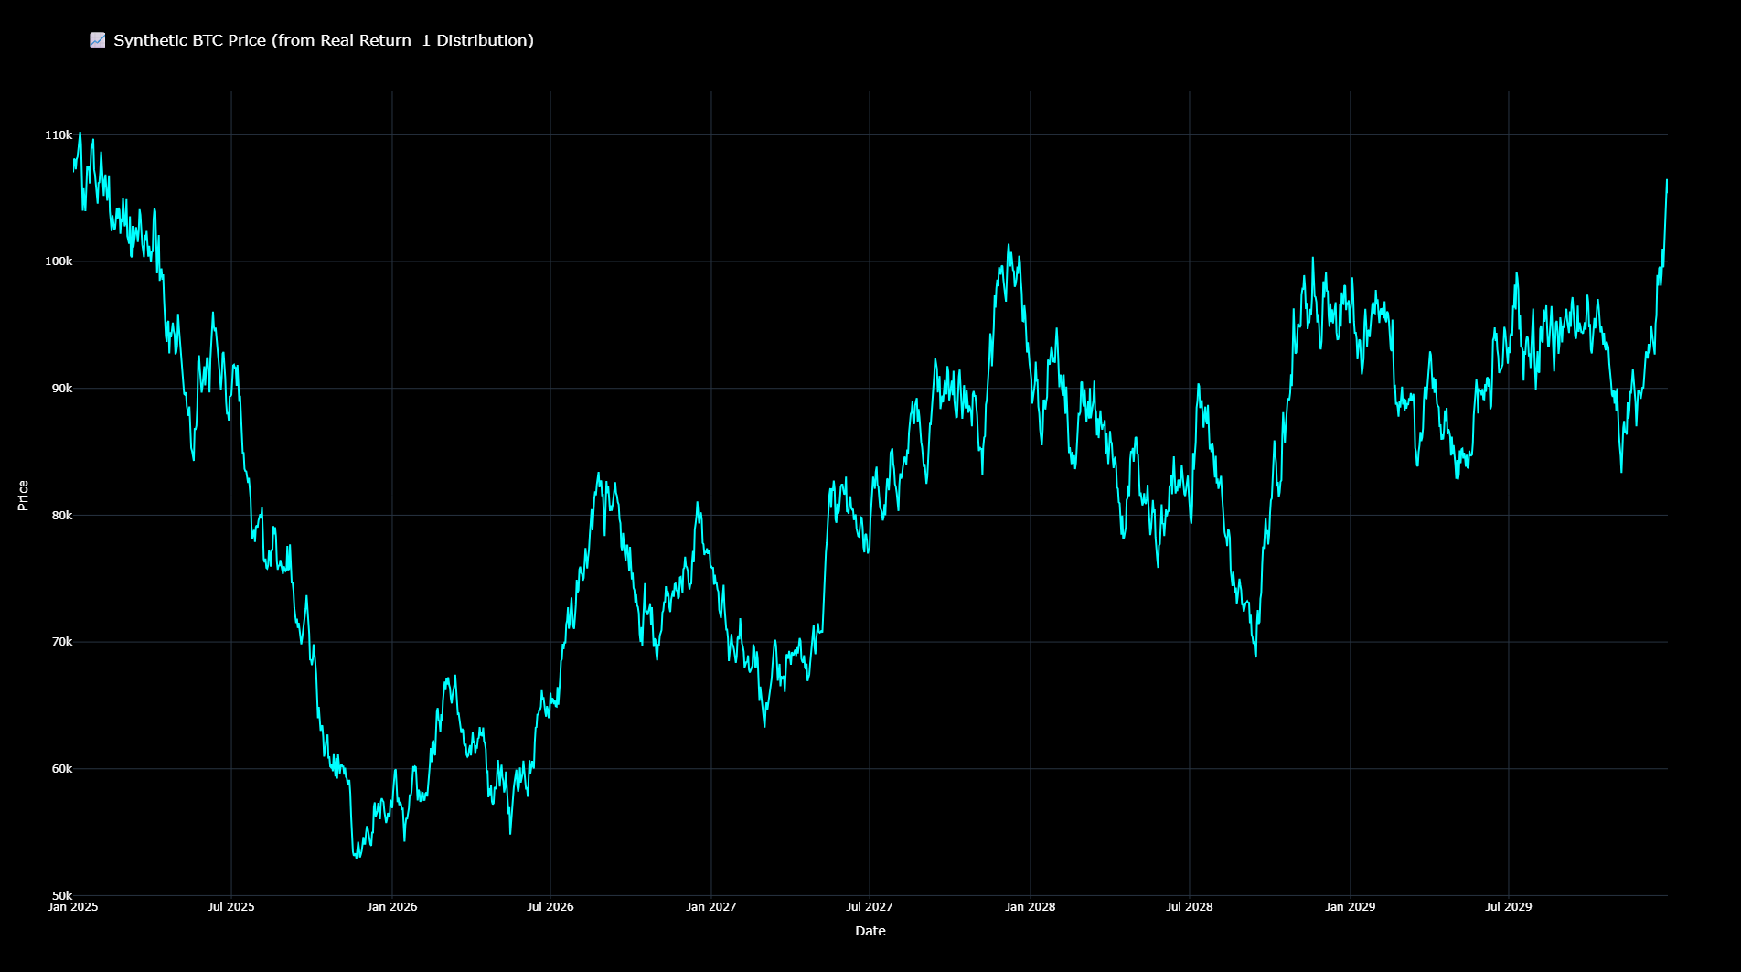
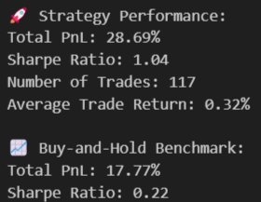
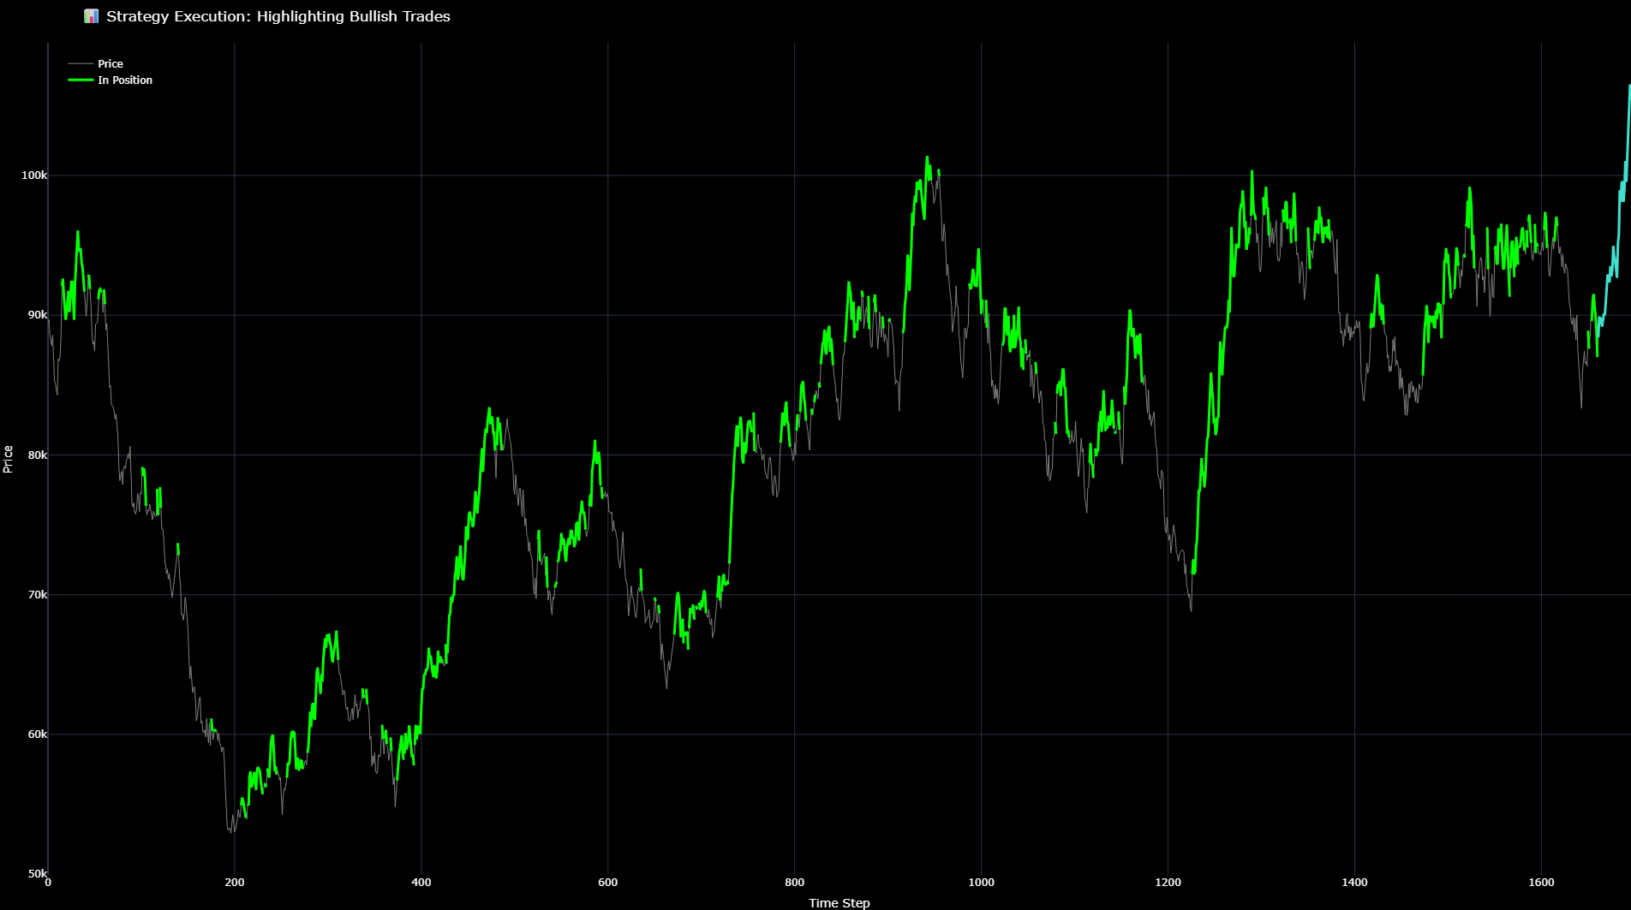
Back Testing a Sideways Market
Synthetic Price Chart (Buy-and-Hold)
Highlighted Trades

Slide 22
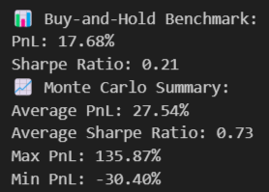
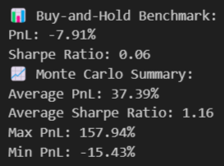
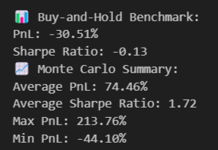
Monte Carlo Back Testing
Call generate_synthetic_market() to generate a synthetic dataframe and run a simulation with classify_regimes()
Record PnL and Sharpe Ratio of our trading strategy and buy-and-hold
Repeat n = 100 times and compare average results:

Slide 23
Key Findings
Despite our simulation’s limitation, the HMM strategy consistently produces higher Sharpe ratios than a buy-and-hold
In bull markets, buy-and-hold may outperform in raw PnL — but our strategy manages risk more effectively
In sideways or bearish markets, the strategy often outperforms in both PnL and Sharpe

Slide 24
Takeaway
Real-time regime classification lowers downside exposure while still capturing upside
Confirms that HMMs, when trained on structured regime signals, can be highly effective for live, time-aware trading

